Slide 1


Gestão de Projecto de Software
Licenciatura em Engenharia Informática
2024/2025
Sprint ceremonies

Slide 2

Team roles and responsibilities
TEMPLATE!
Product Owner
Software developer
QA Engineer
Prepare
Prioritize
Select
Develop
Push once ready to test
Push to validate AC (After 2 approves from the team)
Push once validated
Product Backlog
US 5
US 6
US 7
...
Sprint
Backlog
US 1
US 2
US 3
...
dev
QA
Main
Scrum Master

Slide 3
Gestão de Projecto de Software
Licenciatura em Engenharia Informática
2024/2025
Sprint #1
Review

Slide 4
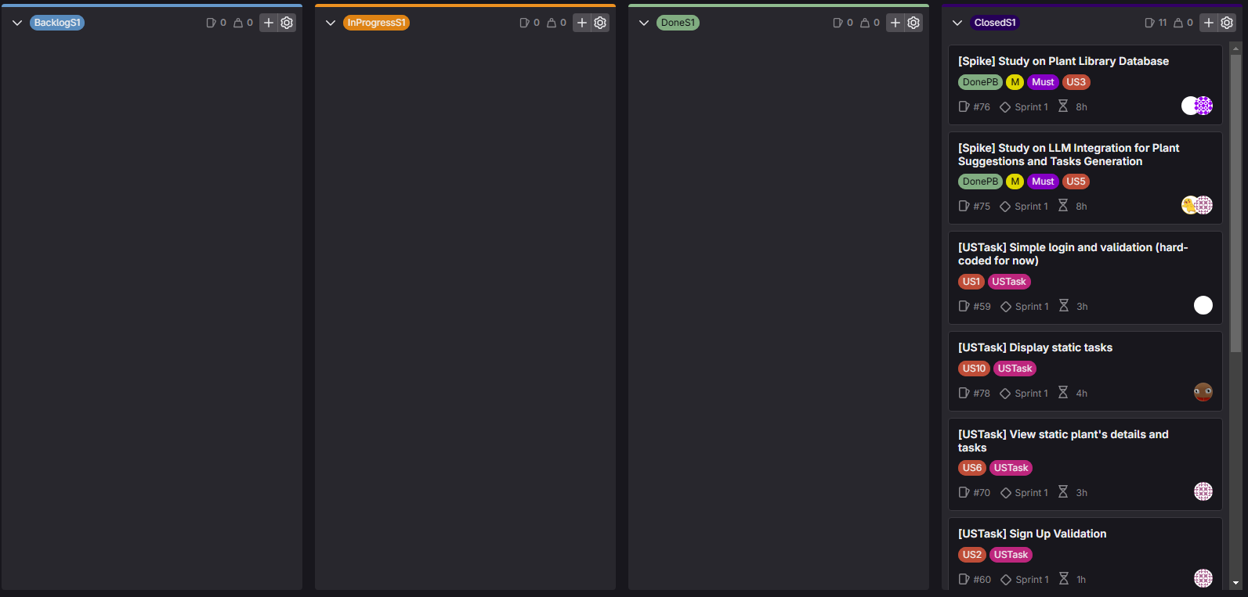
Sprint #1 Review
Notes:
Snapshot of the sprint board

Slide 5

DEMO

Slide 6
Sprint #1 Review
PLANNED
N. User Stories: 5
Sprint capacity: 40h
Product Owner: 2h
Scrum Master: 1h
Software Developers: 37h
DONE
N. User Stories: 7 🟢
Sprint capacity: 44h 🟡
Product Owner: 3h 🟡
Scrum Master: 1h 🟢
Software Developers: 40h 🟡

Slide 7
Gestão de Projecto de Software
Licenciatura em Engenharia Informática
2024/2025
Sprint #1
Retrospective

Slide 8
Sprint #1 Retrospective
KEEP DOING 👍
Item | Action item | Action owner
The use of the SceneBuilder program helped save a lot of time |  | Team
Bi-weekly team meetings helped keeping everyone up to date |  | Team
TO IMPROVE 📈
Item | Action item | Action owner
Overestimation | Don’t be as conservative about time management | Team

Slide 9
Gestão de Projecto de Software
Licenciatura em Engenharia Informática
2024/2025
Sprint #2 Planning

Slide 10
Sprint #2 Planning
PLANNED
N. User Stories: 5
Sprint capacity: 40h
Product Owner: 3h
Scrum Master: 1h
QA Engineer: 2h
Software Developers: 34h
SPRINT GOAL
Integrate the sign-up and login functionalities with the database
Implement the plant library with database management
Enable survey submission for recommendations
Integrate LLM for task generation in maintenance timelines

Slide 11
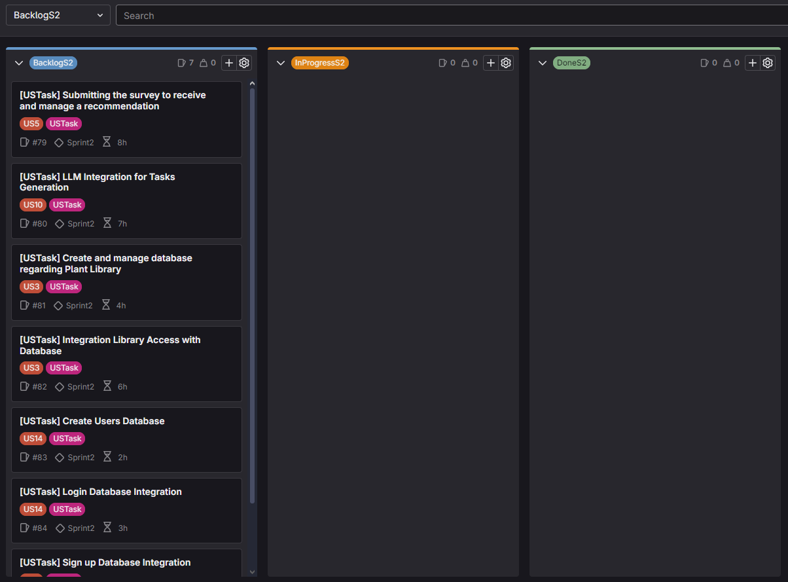
Sprint #2 Planning

Slide 12


